Slide 1



IPL Analysis of RCB's Performance
A Data-Driven Approach Using Cricket Database Submitted By – Vishal Gir Goswami
Date – 14-02-2024

Slide 2
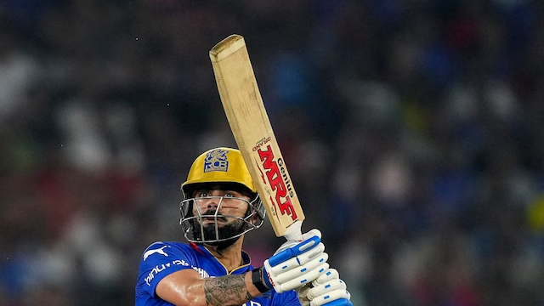
Introduction to IPL
📜 Brief History:
Launched in 2008 by BCCI, revolutionizing franchise cricket.
Inspired by global sports leagues (e.g., NBA, EPL).
🏏 Format:
T20 format: Fast-paced matches (~3 hours).
10 teams (as of 2022) representing different cities.
Mega auction allows franchises to bid for international & Indian players.
🌍 Importance & Key Stats:
500M+ viewers globally (Star Sports & JioCinema).
Most expensive cricket league (₹48,390 Cr media rights for 2023-2027).

Slide 3
Problem Statement
📊 Objective:
Analyze team and player performance across IPL seasons.
Identify key trends, strengths, and weaknesses.
Provide data-driven insights for better team strategies.
🔍 Key Challenges:
Performance Variability – How do teams perform across different seasons?
Player Consistency – Which players maintain high impact over time?
Winning Factors – What factors contribute to match wins (batting, bowling, toss, etc.)?
Team Strategies – How can teams optimize auctions, squad selection, and game tactics?

Slide 4
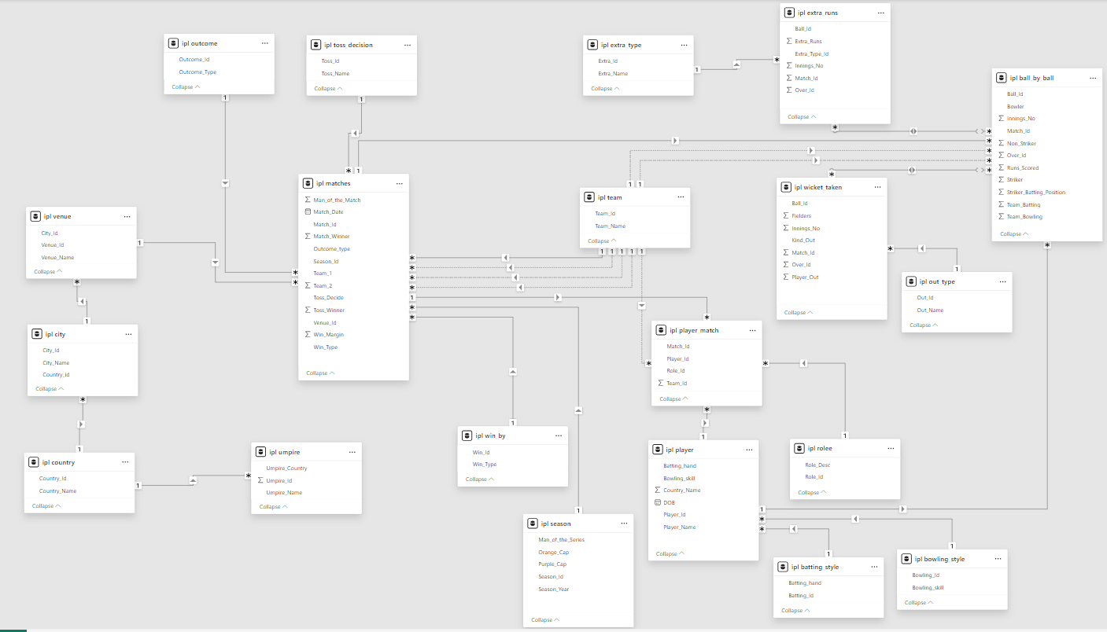
Data Overview

Slide 5
IPL Dataset Overview
Ball_by_Ball – Detailed ball-by-ball match events
Batting_Style – Batsmen’s preferred batting hand
Bowling_Style – Bowlers’ skills and bowling style
City – Cities where matches were played
Matches – Match details, outcomes, and winners
Venue – Stadium details for matches
Country – Countries of teams and players
Player_Match – Players' performance in matches
Wickets_Taken – Data on dismissals and bowlers
Extra_Type – Types of extra runs conceded
Season – IPL season-wise match data
Win_By – Match win type (runs/wickets) and margin
Outcome – Match results (win, loss, tie, etc.)
Out_Type – Types of dismissals in matches
Rolee – Players’ roles (batsman, bowler, all-rounder)
Team – Team details and names
Umpire – Umpire details and nationality
Toss_Decision – Toss details and decision
Player – Players’ names and unique IDs
Extra_Runs – Additional runs conceded per ball

Slide 6
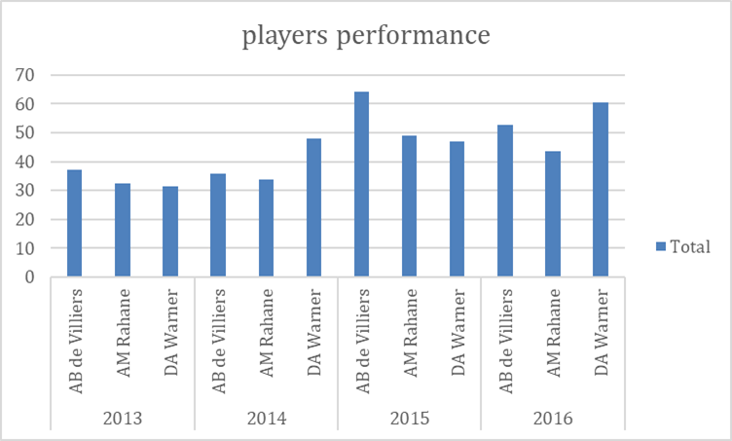
Player Performance Analysis

Slide 7
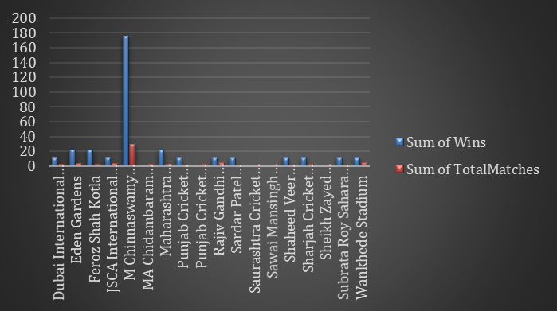
Venue Analysis

Slide 8
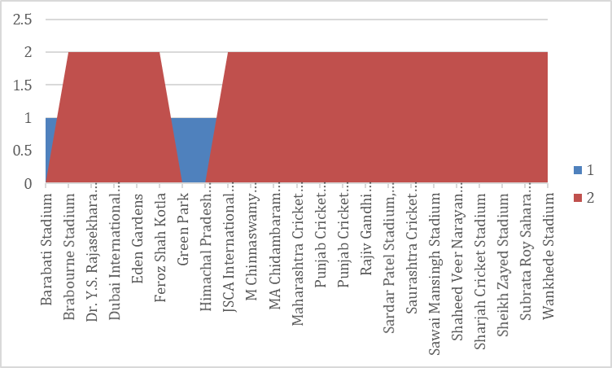
Toss Impact on Match Outcomes
Correlation Analysis:
Teams winning the toss have a higher chance of winning (~52-55%).
Some teams strategically choose to chase, while others prefer setting a target.

Slide 9
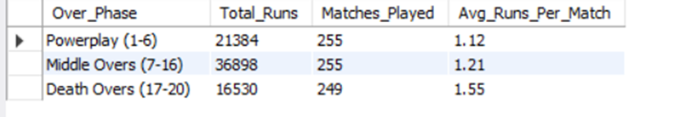
Death Overs Analysis (Overs 16-20)

Slide 10
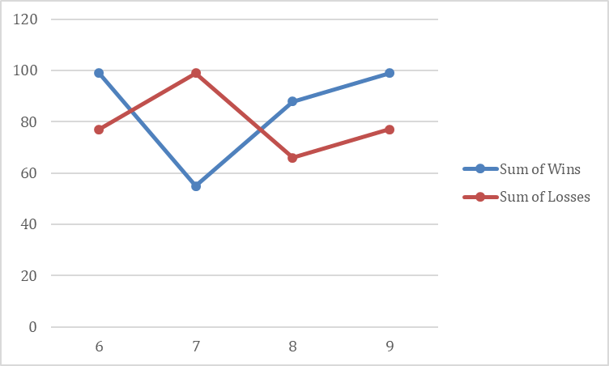
RCB's past season's performance

Slide 11
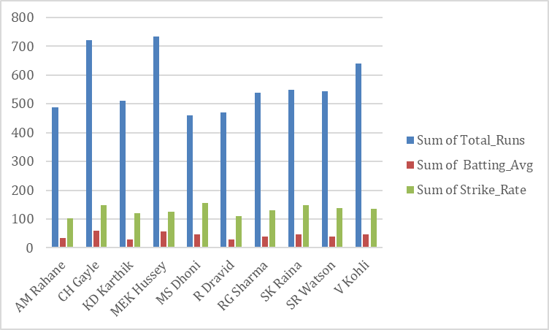
players have consistently performed

Slide 12
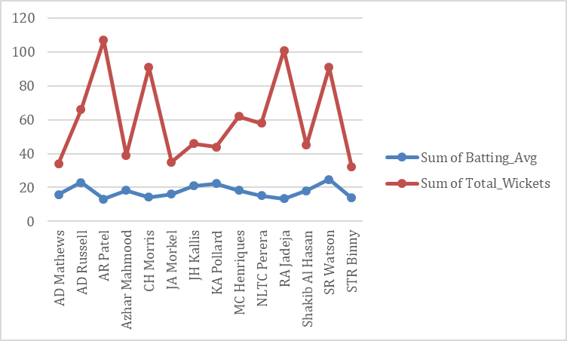
players who excel in both batting and bowling

Slide 13
Conclusion
✅ Key Findings:
Identified team performance trends and strengths.
Highlighted top-performing players and match-winning factors.
Analyzed crucial aspects like toss impact and death-over performance.
✅ Importance of Data-Driven Decision-Making:
Teams can optimize strategies using analytics.
Player selection, match tactics, and training can be enhanced with data insights.
✅ Future of IPL & Its Global Impact:
IPL continues to revolutionize cricket with innovations.
Expanding global influence, attracting talent worldwide, and shaping modern T20 strategies.

Slide 14



Slide 15


